Slide 1
IMPLEMENTATION DESIGN FOR FASTER ENCRYPTION IN RSA
Under the Guidance of Mr. Biswanath Dey

Slide 2
Team Members
Suhrid Barthakur 14-1-5-039
Partha Pritam Paul 14-1-5-059
Jasbir Singh Birdi 14-1-5-083
Anirban Chatterjee 14-1-5-032

Slide 3
Introduction
Encryption is what guarantees the security of sensitive information. It provides the mechanisms in information confidentiality, functioned with digital signature, authentication, secret sub-keeping, system security and etc.
At present, the best known and most widely used public key system is RSA
Here , we are to propose an implementation design/procedure for faster encryption process mainly through optimizing the modular exponentiation process for large key of sizes 1024 bits or more.

Slide 4
Introduction(Cont.)
The design provides a recoding scheme and makes use of montgomery multiplication for reducing the total no. of operations and faster modular multiplication respectively.
The design is based on parallel processing by two processor for achieving optimal performance.In addition to this a systolic array design is implemented to provide potentially higher throughput for a large number of computations

Slide 5
Introduction(Cont.)
For better security it has been found that the large size key are hard to factorize ,and the integrity of the RSA system depends solely on factorization of N which is the product of two large prime numbers. As it can seen from the RSA algorithm:

Slide 6
Proposed Work
The proposed implementation design aims to make the RSA cryptosystems faster through faster encryption and decryption process
The encryption is slow process when the key size is large like 1024 bits ,2048 bits or greater (for better security) ,due to computation of modular exponentiation C=M^E (mod N) which becomes expensive for large public key (E,N).
Thereby the design makes the modular exponentiation faster by making use of parallel processing and montgomery multiplication technique. Also a corresponding systolic array design is developed.

Slide 7
Proposed Work(Cont.)
The well known algorithm for computing M^E is exponentiation by repeated squaring and multiplication and called the binary algorithm. Computing M^E (mod N) by this algorithm requires 2|log E | modulo multiplications in the worst case where N is the product of two large prime numbers.
Our work consists of three main parts: Recoding, Montgomery Multiplication and Parallel Processing.

Slide 8

Modular Exponentiation Algorithm(RECODING)
Recoding
The proposed technique in order to compute C= ME mod N, involves representing E in recoded binary form, unlike binary algorithm which represents E in binary.
i.e
,where n is number of bits in E and e_{i}​ ∈{0,1} similar to binary algorithm.
Now it known that the binary algorithm requires (n + E1) total operations, where E1 is no of 1's representation in binary representation of E and n is the number of bits in E. Thus we need to reduce the value of E1 in order to make it faster.

Slide 9

Modular Exponentiation Algorithm(RECODING)
To achieve this ,we define a redundant expression of E say E'(E= E') which is given as:
,where e​i​*​∈ {0,1,-1} and is a redundant representation of E in base of 0 ,1 ,-1.

Slide 10
Modular Exponentiation Algorithm(RECODING)
Let us represent -1 in the redundant representation as 1
For example E=11110=100010=100000-10
Thus as in the above example used reduce the number of non zero digit with the help of the redundant expression. For any given integer E, E<2^n ,the time complexity of computing C= ME mod N is (n+|n/2 |+1) Tn , by applying the recording algorithm and redundant binary algorithm which will be faster by using the proposed algorithm .

Slide 11
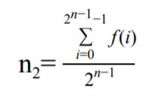
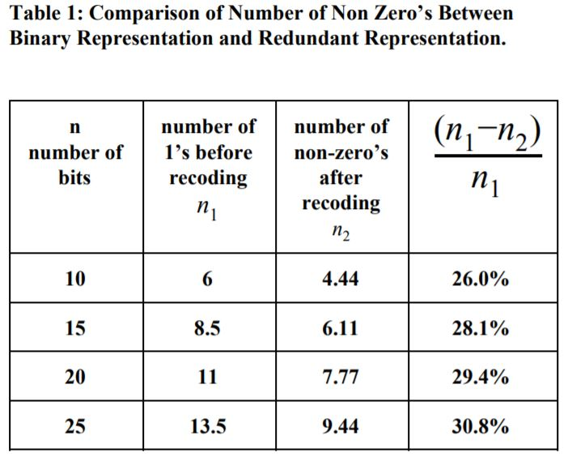
Modular Exponentiation Algorithm(RECODING)
The average number of non-zero’s after applying the recoding algorithm for the integers distributive in the range of 2^(n-1) and (2^n) -1 can be calculated by the following equation:
Table 1 shows the comparison of the number of non-zero elements between the original integer and the recoded one.

Slide 12
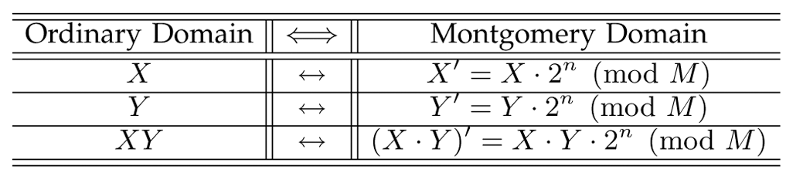
Modular Exponentiation Algorithm(MONTOGOMERY REDUCTION)
Now in order to perform a modular exponentiation we use the montgomery multiplication Montgomery modular multiplication, more commonly referred to as Montgomery multiplication, is a method for performing fast modular multiplication. For computations using montgomery multiplication , first perform modular exponentiation in Montgomery form ,and then convert back the obtained result out of montgomery form to obtain the required result i.e C =M^E mod N.
For montgomery multiplication it is defined as, given an integer a < n , where N is the k-bit modulus, A is said to be its N-residue with respect to R if , A = a*R (mod N) , where R=2^k

Slide 13
Modular Exponentiation Algorithm(MONTOGOMERY REDUCTION)
The Montgomery product of A and B can then be defined as: Z = A*B*R' (mod N), where R' is the inverse of R, modulo n. i.e RR'= 1 (mod N).
Since GCD(N,R')=1 ,extended Euclidean algorithm can efficiently determine integers R' and N' that satisfy Bézout's identity: 0<R'<N, 0<N'<R and RR'-NN'=1..
The montgomery reduction computes this product Z in montgomery form as given by REDUCE, where X =( AR mod N )*(BR mod N). function REDUCE(X) begin q := (X mod R)N' mod R; Z := (X + qN)/R; if Z > N then Z := Z−N;
return Z; end This reduction algorithm is used for converting in and out of Montgomery form and calculating the Montgomery product. And hence can be used for modular exponentiation algorithm

Slide 14
Modular Exponentiation Algorithm(THE ALGORITHM)
For computing C= M^E (mod N) ,repeat the following steps of the algorithm. It is assumed that R', N' and R are predetermined as required for montgomery reduction.
Input M as integer , E as E' i.e. redundant representation of binary expression for E and N as integer value
Take a variable result to store the temporary result for each iteration .Initialize result as the montgomery form of 1.Thus we initialize result= R mod N , where gcd(R,N) =1 and R>N.
If k is the no of bits in E then starting from most significant bit in E i.e. (k-1)th bit to the least significant bit, and for each bit i from k-1 to 0 do the following:
Step 3a :
result=REDUCE((result.R mod N)*(result.R mod N))
result= (result. R') mod N

Slide 15
Modular Exponentiation Algorithm(THE ALGORITHM)
Step 3b :
If the ith bit is 1 then set
result=REDUCE((result.R mod N)*(M.R mod N)) result=result.R' mod N
OR
If the ith bit 1 then set
result=REDUCE((result.R mod N)*(M^(-1).R mod N)) result=result.R' mod N
OR
else if the ith bit is 0 then set result=result

Slide 16
Modular Exponentiation Algorithm(THE ALGORITHM)
4. After completion of all iterations return result, which is in Montgomery form and we convert it out of Montgomery form to obtain the final result of encryption C=REDUCE(result . R mod N)=M^E (mod N).
.
The algorithm computes modular exponentiation in O((T(n))(n+E1)) where T(n) is time complexity of Montgomery reduction algorithm, n is the no. of bits in redundant representation of E and E1 is no of non zero elements in redundant representation
This is much faster in comparison to the binary algorithm which has complexity of O(M(n)(n +Z)),n being the number of bits in E,Z being the no of 1’s in the binary form of E. M(n) is time complexity for performing modular multiplication . Since M(n) > T(n) and E1 < Z.

Slide 17
REFERENCE
REFERENCES
[1] Chang N.Zhang , Herold L.Martin, “Parallel algorithms and Systolic Array Design For RSA Cryptosystems” Systolic Arrays, 1988., Proceedings of the International Conference on 25-27 May 1988,San Diego, CA, USA, USA.
[2] Martin Kochanski, "Montgomery Multiplication" a colloquial explanation.
[3] Alfred J. Menezes, Paul C. van Oorschot, and Scott A. Vanstone. “Handbook of Applied Cryptography”. CRC Press, 1996. ISBN 0-8493-8523-7, chapter 14.
[4] N. Petkov: Systolic Parallel Processing; North Holland Publishing Co, 1992
[5] S. Y. Kung: VLSI Array Processors; Prentice-Hall, Inc., 1988
[6] H. T. Kung, C. E. Leiserson: Algorithms for VLSI processor arrays; in: C. Mead, L. Conway (eds.): Introduction to VLSI Systems; Addison-Wesley, 1979
[7]A Parallel Implementation of Montgomery Multiplication on Multicore Systems: Algorithm, Analysis, and Prototype,Issue No. 12 - December (2011 vol. 60) Zhimin Chen , Virginia Polytechnic Institute and State University, Blacksburg,Patrick Schaumont , Virginia Polytechnic Institute and State University, Blacksburg.

Slide 18
THANK YOU

